Slide 1
DATA ANALYTICS PORTFOLIO
Retail Sales &
Discount Profitability
Analysis
Furniture earns a 2.61% margin.
East Tables are the first priority for review.
Wilshen Aristo Budianto
01
Notes:
This portfolio case uses the supplied Superstore CSV and PostgreSQL script. The business decision is where to review discount policy. All final amounts use unrounded CSV values before aggregation and display rounding. This is descriptive analysis, not an experiment.

Slide 2
Furniture sales are substantial,
but profit is thin
Business context and the decision for merchandising and finance
754,747.76
The decision
Which products and regions need a pricing and discount review before the next promotion?
Furniture sales
19,730.00
Furniture profit
Portfolio case based on supplied retail sales records.
Source: samplesuperstore(2).csv; supplied SQL aggregation logic. Amounts in dataset units.
02
Notes:
Business context is a decision framing for this portfolio, not a claim about a real retailer's current policy. Furniture has 2,201 sales lines, sales 754,747.7613 and profit 19,729.9956, giving 2.6141228% aggregate margin.

Slide 3
Sales, profit and margin identify
where discount policies need review
Scope: all records, followed by Furniture, Tables and Bookcases
Business question
Sales = SUM(sales)
Profit = SUM(profit)
Margin = SUM(profit) / SUM(sales) × 100
Sales lines = COUNT(*)
Unique orders = COUNT(DISTINCT order_id)
Which product categories generate strong sales but weak profit, and where should discount policies be reviewed?
Compare category, subcategory, discount group and region. Margins use aggregate totals.
Source: samplesuperstore(2).csv; supplied SQL aggregation logic. Amounts in dataset units.
03
Notes:
Use sales lines for row counts and unique orders only for distinct Order ID counts. Never average row-level margins to obtain group margin. SQL uses NULLIF to protect division by zero. No causal effect or experiment is estimated.

Slide 4
10,194 sales lines represent
5,111 unique orders
Data preparation preserves source precision and all records
10,194
PostgreSQL workflow
Parse Order Date and Ship Date.
Cast Sales, Profit and Discount to numeric.
Create public.superstore_clean.
Aggregate using the supplied SQL groups.
sales lines retained
0
duplicate Row IDs
or missing source values
Source period: 3 Jan 2023–30 Dec 2026.
Includes future-dated records relative to Sep 2026.
Currency is unspecified. No outlier rows removed.
Source: supplied CSV and SQL. CSV recheck found small differences from the reported DBeaver totals.
04
Notes:
Independent recalculation from CSV, not an execution against the user's database. CSV contains 21 fields, 10,194 rows, 5,111 unique Order IDs, no missing source values, no duplicated rows or Row IDs. Dates parse with MM/DD/YYYY; 3 Jan 2023 to 30 Dec 2026. The supplied SQL creates a typed view and does not remove outliers. The CSV includes United States and Canada. Reconciliation, reported DBeaver -> CSV: Furniture sales 754747.74 -> 754747.76; profit 19730.02 -> 19730.00. Tables sales 208020.15 -> 208020.18; profit -17753.20 -> -17753.21. Bookcases sales 115361.22 -> 115361.20; profit -3632.07 unchanged. Furniture discount profits: 59477 -> 59476.99; 15209.30 -> 15209.29; -29365.36 and -25590.92 unchanged. East Tables sales 39926.13 -> 39926.15; profit -11086.15 unchanged. East discounted sales 39860.62 -> 39860.64; profit -11116.89 unchanged. Three no-discount lines yield 30.74 unchanged. Counts and stated two-decimal margins agree. Cause of discrepancies is unverified.

Slide 5
Furniture has 32.44% of sales,
but only 6.75% of profit
Category comparison: sales and profit share the same scale
Sales
Profit
Margin
Technology
839,893.28
146,543.38
17.45%
Furniture
754,747.76
19,730.00
2.61%
Office Supplies
731,893.31
126,023.44
17.22%
0
450,000
900,000
Source: samplesuperstore(2).csv; supplied SQL aggregation logic. Amounts in dataset units.
05
Notes:
Exact category values appear in labels. Total sales 2,326,534.3543 and profit 292,296.8146. Furniture sales share 32.441%, profit share 6.750%. Bars show Sales in blue and Profit in teal on a common 0–900,000 scale, dataset units. Category margin is aggregate profit divided by aggregate sales.

Slide 6
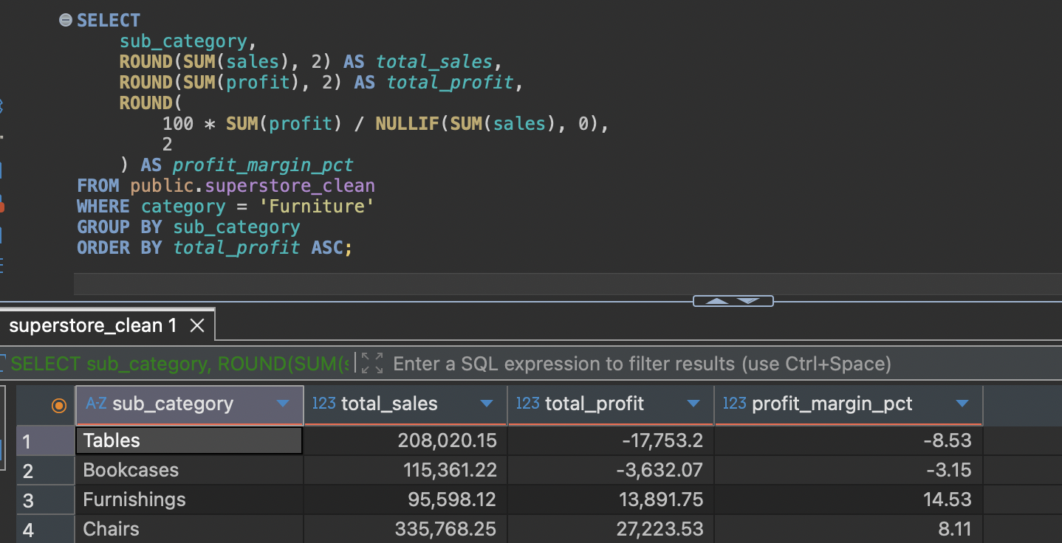
Tables and Bookcases reduce
Furniture profit by 21,385.28
SQL groups Furniture sales lines by subcategory and calculates aggregate margins.
Profit from CSV
Chairs
27,223.53
Furnishings
13,891.74
Bookcases
-3,632.07
Tables
-17,753.21
−20k
0
30k
Profit, dataset units
Source: DBeaver screenshots + CSV. Small decimal differences remain; deck figures use CSV precision.
06
Notes:
Screenshot evidence added from the user's DBeaver session. Screenshot is unaltered and displays the database's own results; narrative and chart figures retain verified CSV totals. Minor decimal discrepancies are not evidence of a different substantive conclusion. Their cause has not been confirmed.
Chairs profit 27,223.5323; Furnishings 13,891.7430; Bookcases -3,632.0736; Tables -17,753.2061. Combined loss -21,385.2797, against positive profit 41,115.2753. Table sales 208,020.1820; Bookcases sales 115,361.2043. Aggregate subcategory margins are -8.53437% and -3.14844%.

Slide 7
Furniture discounts above 20%
coincide with 54,956.29 in losses
Observed groups differ in their product mix and sales-line counts
Profit, dataset units
0%
59,476.99
>0–20%
15,209.29
>20–40%
-29,365.36
>40%
-25,590.92
-35k
0
65k
Sales lines by group: 880 / 766 / 326 / 229.
The >20% groups contain 555 lines. This comparison does not establish causation.
Source: samplesuperstore(2).csv; supplied SQL aggregation logic. Amounts in dataset units.
07
Notes:
Discount definitions follow SQL: 0%; greater than 0 through 20%; greater than 20 through 40%; above 40%. Actual discounts are nonnegative. Profit by group: 59,476.9872; 15,209.2941; -29,365.3614; -25,590.9243. Higher discounts may correlate with product mix or other conditions. No experimental assignment, p-values or causal estimate are present.

Slide 8
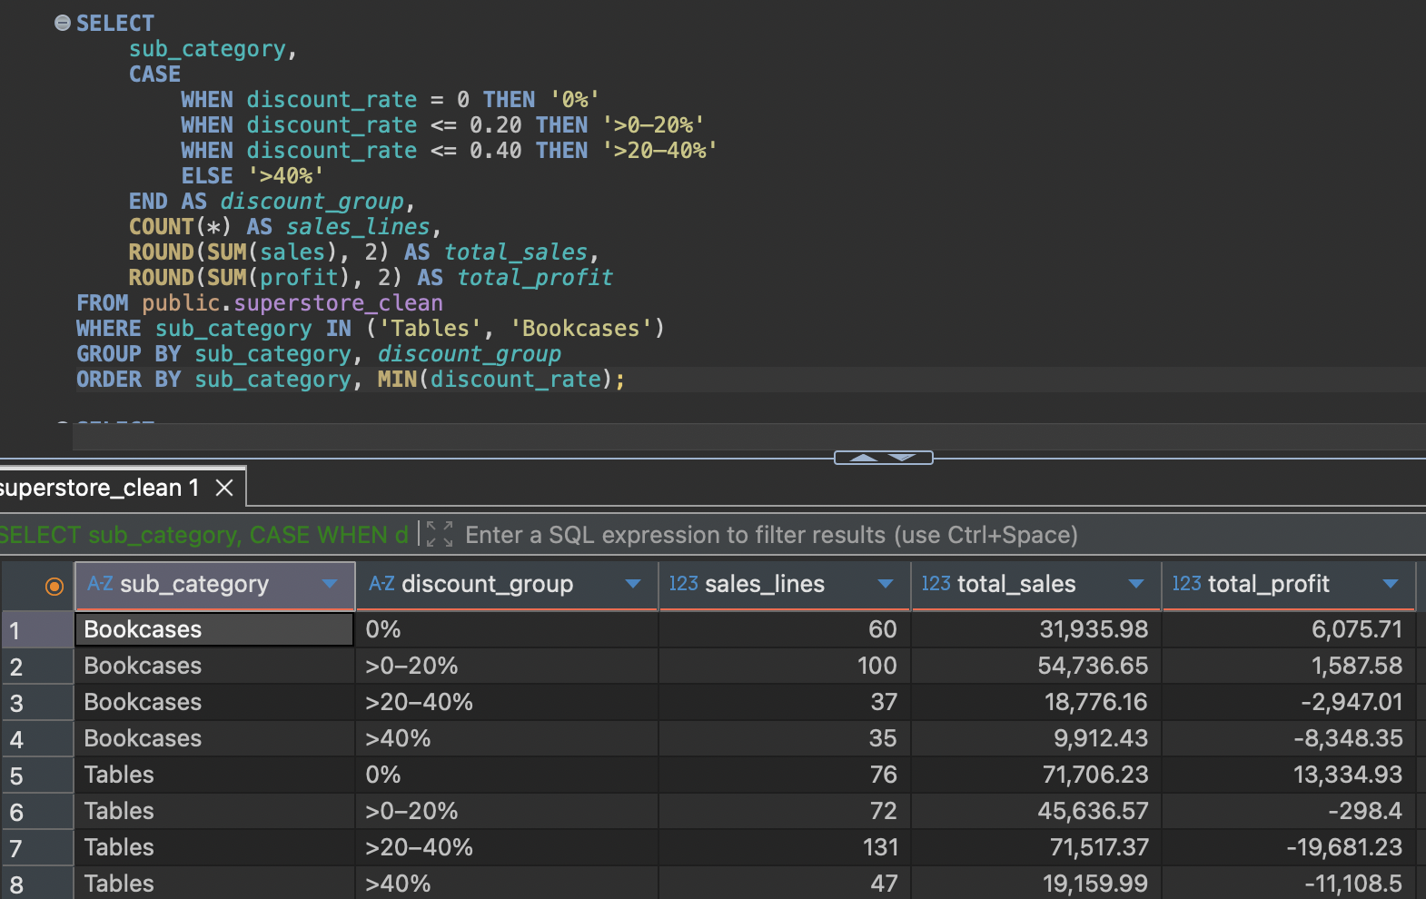
Tables show a loss even in
the >0–20% discount group
Tables: −298.40
Profit in the >0–20% group.
A 20% cap alone does not
ensure profitability.
Both subcategories
show losses in each group
above 20% discount.
This pattern is descriptive.
Source: DBeaver screenshots + CSV. Small decimal differences remain; deck figures use CSV precision.
08
Notes:
Screenshot evidence added from the user's DBeaver session. Screenshot is unaltered and displays the database's own results; narrative and chart figures retain verified CSV totals. Minor decimal discrepancies are not evidence of a different substantive conclusion. Their cause has not been confirmed.
Profit and sales by subgroup at full CSV precision: [{"Sub-Category":"Bookcases","group":"0%","lines":60,"sales":31935.98,"profit":6075.7117,"margin":19.024660273459588},{"Sub-Category":"Bookcases","group":">0–20%","lines":100,"sales":54736.6375,"profit":1587.5796999999989,"margin":2.900396832012195},{"Sub-Category":"Bookcases","group":">20–40%","lines":37,"sales":18776.1568,"profit":-2947.0103000000004,"margin":-15.695492594096788},{"Sub-Category":"Bookcases","group":">40%","lines":35,"sales":9912.43,"profit":-8348.3547,"margin":-84.22107091802917},{"Sub-Category":"Tables","group":"0%","lines":76,"sales":71706.23,"profit":13334.9247,"margin":18.596605483233468},{"Sub-Category":"Tables","group":">0–20%","lines":72,"sales":45636.582,"profit":-298.3980000000008,"margin":-0.6538570307478347},{"Sub-Category":"Tables","group":">20–40%","lines":131,"sales":71517.386,"profit":-19681.2344,"margin":-27.51951029082635},{"Sub-Category":"Tables","group":">40%","lines":47,"sales":19159.984,"profit":-11108.4984,"margin":-57.97759747607305}]. Negative Tables profit at >0–20% means the descriptive pattern does not justify a universal safe discount cap. Review price and cost at product level.

Slide 9
East Tables show the largest loss
among the regional combinations
Profit by region, using the same scale in both charts
Tables
Bookcases
Profit, dataset units
Profit, dataset units
Central
-3,559.65
Central
-1,997.90
East
-11,086.15
East
-1,365.24
South
-4,623.06
South
1,339.49
West
1,515.65
West
-1,608.43
-12k
0
2k
-12k
0
2k
Tables earn positive profit only in West.
Bookcases earn positive profit only in South.
Source: samplesuperstore(2).csv; supplied SQL aggregation logic. Amounts in dataset units.
09
Notes:
Regional sales, profit, margin and line counts: [{"Sub-Category":"Bookcases","Region":"Central","lines":50,"sales":24157.1768,"profit":-1997.9043000000004,"margin":-8.270437876664463},{"Sub-Category":"Bookcases","Region":"East","lines":72,"sales":43963.922,"profit":-1365.2354000000007,"margin":-3.105353976380908},{"Sub-Category":"Bookcases","Region":"South","lines":28,"sales":10899.362,"profit":1339.4918,"margin":12.289634934595256},{"Sub-Category":"Bookcases","Region":"West","lines":82,"sales":36340.7435,"profit":-1608.4257000000002,"margin":-4.425957052859968},{"Sub-Category":"Tables","Region":"Central","lines":72,"sales":39154.971,"profit":-3559.6504,"margin":-9.091183849938236},{"Sub-Category":"Tables","Region":"East","lines":85,"sales":39926.147,"profit":-11086.1471,"margin":-27.766633980484016},{"Sub-Category":"Tables","Region":"South","lines":51,"sales":43916.192,"profit":-4623.0579,"margin":-10.527000838324051},{"Sub-Category":"Tables","Region":"West","lines":118,"sales":85022.872,"profit":1515.6492999999994,"margin":1.7826371473313667}]. The largest loss among the eight combinations is East Tables: -11,086.1471. This is 62.45% of Tables' net loss, a ratio to net rather than gross losses. Regional names follow the dataset.

Slide 10
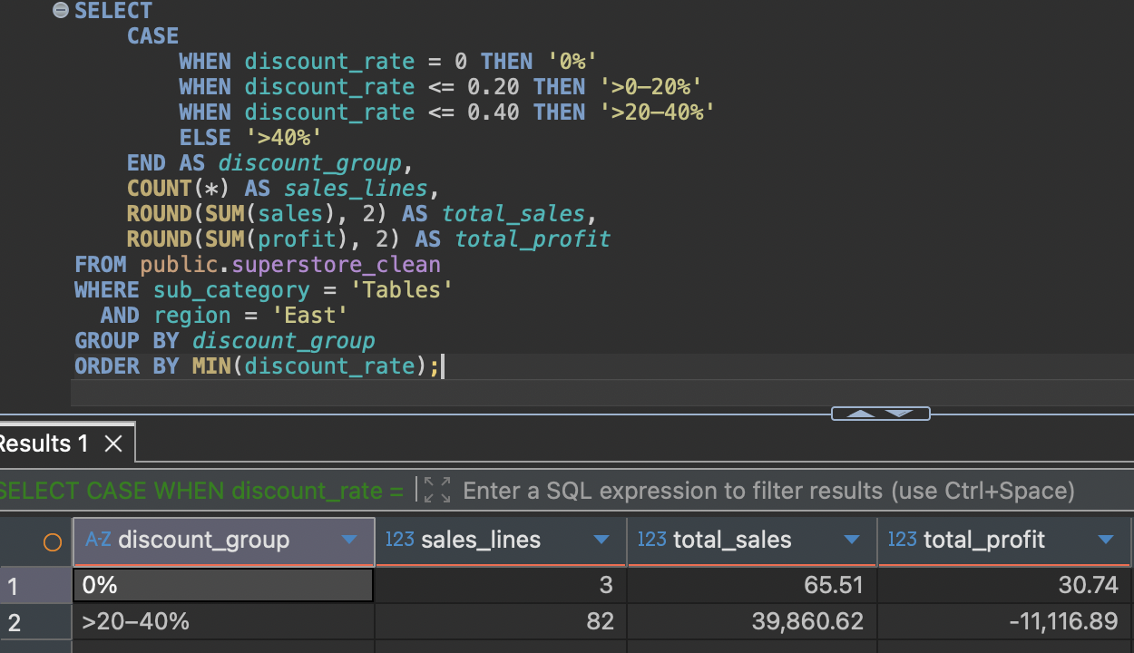
82 of 85 East Tables lines carry
>20–40% discounts
96.47%
of East Tables lines
have >20–40% discounts.
−11,116.89
profit in that group
Only 3 no-discount lines.
Too few for a reliable
comparison benchmark.
Source: DBeaver screenshots + CSV. Small decimal differences remain; deck figures use CSV precision.
10
Notes:
Screenshot evidence added from the user's DBeaver session. Screenshot is unaltered and displays the database's own results; narrative and chart figures retain verified CSV totals. Minor decimal discrepancies are not evidence of a different substantive conclusion. Their cause has not been confirmed.
East Tables has 85 lines. 82/85 = 96.4706%. Discounted sales 39,860.637 / East Tables sales 39,926.147 = 99.8359%. Three no-discount lines total 65.51 sales and 30.743 profit. The sample is very small and product mix is uncontrolled. Do not claim removing discounts would recover the observed losses.

Slide 11
East Tables pricing needs review
before the next promotion
Proposed actions and validation checks, with no assumed profit uplift
Commercial actions
Validation and limits
Merchandising + Finance
Audit East Tables list prices, cost inputs
and discount rules at product level.
Reconcile CSV and database precision.
Confirm dates, currency and profit definition.
Review product mix and discount eligibility.
Track margin and loss-making lines by region.
Promotion owner
Review profitability above 20% before
approval. Check lower discounts on Tables too.
Observational data cannot establish causality.
Only 3 East Tables lines have no discount.
Source records extend to December 2026.
Proposed responsibilities and checks. No experiment, causal effect or projected profit gain is claimed.
11
Notes:
Suggested validation plan: first reconcile imported database values against full CSV precision. Obtain list prices, unit costs, freight and returns treatment, discount eligibility, and actual reporting cut-off. Review like-for-like product and regional composition where sufficient records exist. Before the next promotion, commercial owners assess margin exposure and exceptions. Then monitor sales, aggregate margin, total profit and count of loss-making lines descriptively. There is no A/B test, p-value or causal promise. The file contains no standalone price/cost or profit accounting definition sufficient to validate underlying unit economics.

Slide 12
Furniture is the review priority.
East Tables is the starting point.
2.61%
The next decision
Audit pricing and costs.
Review discount rules before
committing the next promotion.
Furniture profit margin
−11,086.15
East Tables profit
Wilshen Aristo Budianto
Questions & discussion
12
Notes:
Key takeaway: Furniture generates substantial sales but weak aggregate margin. Tables and Bookcases reduce category profit. East Tables has the largest regional loss among these two subcategories, with 82 of 85 lines discounted >20–40%. The evidence supports prioritizing a review, not claiming discounts caused losses. Visual storytelling was inspired by the supplied Anggita Gloria portfolio, without reusing its brand, wording, figures or experiment.

